Slide 1
Strategic Sequential Voting in Multi-Issue Domains and Multiple-Election Paradoxes
Lirong Xia
Joint work with
Vincent Conitzer
Jerome Lang
Sep 9, 2011
Notes:
Feel free to ask questions

Slide 2
Outline
Computational voting theory IMHO
General combinatorial voting (computational perspective)
Strategic sequential voting (game-theoretic perspective)

Slide 3
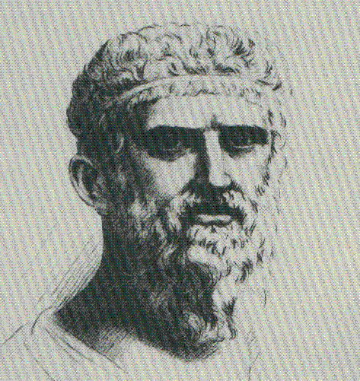
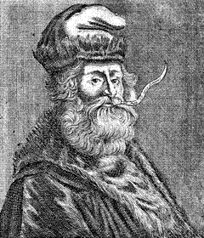
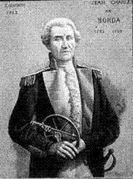
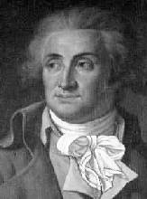
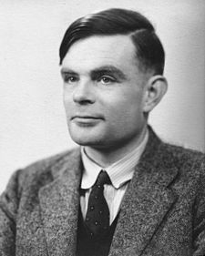
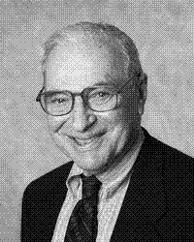
Voting Theory
and Computer Science
Computational thinking
CS
Voting Theory
21th Century
Methods of aggregation
PLATO
4thC. B.C.
LULL
13thC.
BORDA
18thC.
CONDORCET
18thC.
ARROW
20thC.
PLATO et al.
4thC. B.C.---20thC.
TURING et al.
20thC.

Slide 4
Winner determination for traditional voting rules
Time
Most traditional voting rules
# voters
# alternatives

Slide 5
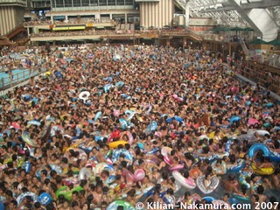
Settings with many alternatives
Representation/communication: How do voters communicate their preferences?
Computation: How do we efficiently compute the outcome given the votes?

Slide 6
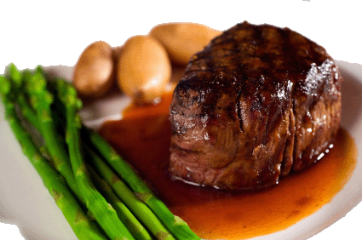
Combinatorial (Multi-issue) domains
Alternatives are uniquely characterized by multiple issues
Let I={x₁,..., x_{p}} be the set of p issues
Let D_{i} be the set of values that the i-th issue can take, then C=D₁×... ×D_{p}
Example:
issues={ Main course, Wine }
Alternatives={ } ×{ }

Slide 7
Example: joint plan [Brams, Kilgour & Zwicker SCW 98]
The citizens of LA county vote to directly determine a government plan
Plan composed of multiple sub-plans for several issues
E.g.,
# of alternatives is exponential in the # of issues

Slide 8
Key questions
What (compact) language should the voters use to represent their true preferences?
How should we aggregate the voters' preferences represented by a compact language?
For the moment we do not consider voters’ strategic behavior
Notes:
Repetitive, but it should be good to emphasize these. We do not consider strategic behavior of the voters

Slide 9
Criteria for combinatorial voting
Criteria for the voting language
Compactness
Expressiveness
Criteria for the voting rule
Computational efficiency
Whether it satisfies desirable axiomatic properties
Usability
Informativeness

Slide 10
Previous approaches
Voting rule | Computational efficiency | Compactness | Expressiveness
 |  |  | Usability | Informativeness
Plurality | High | High | High | Low
Borda, etc. | Low | Low | High | High
Issue-by-issue | High | High | Low | Medium
Looking for a balanced rule!
Notes:
Achieving high in all criteria seems too good to be possible

Slide 11
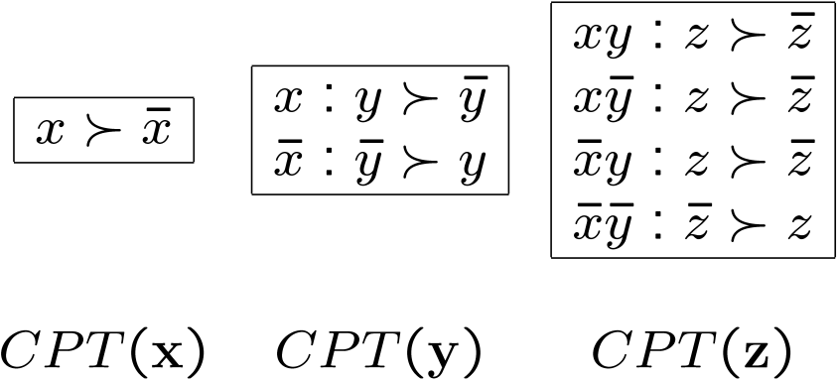
CP-nets: A compact language [Boutilier et al. UAI-99/JAIR-04]
Variables: x,y,z.
Graph CPTs
This CP-net encodes the following partial order:
x
y
z

Slide 12
Truthful sequential voting [Lang IJCAI 07, Lang&Xia MSS 09]
Issues: main course, wine
Order: main course > wine
Local rules are majority rules
V₁: > , : > , : >
V₂: > , : > , : >
V₃: > , : > , : >
Step 1:
Step 2: given , is the winner for wine
Winner: ( , )

Slide 13
Sequential voting vs. issue-by-issue voting
Voting rule | Computational efficiency | Compactness | Expressiveness
 |  |  | Usability | Informativeness
Plurality | High | High | High | Low
Borda, etc. | Low | Low | High | High
Issue-by-issue | High | High | Low | Medium
Sequential voting | High | Usually high | Medium | Medium
Acyclic CP-nets
(compatible with the same ordering)

Slide 14
Other approaches
Voting rule | Computational efficiency | Compactness | Expressiveness
 |  |  | Usability | Informativeness
Plurality | High | High | High | Low
Borda, etc. | Low | Low | High | High
Issue-by-issue | High | High | Low | Medium
Sequential voting | High | Usually high | Medium | Medium
H-composition [Xia et al. AAAI-08] | Low-High | Usually high | High | Medium
MLE approach [Xia,Conitzer, &Lang-AAAI-10] | Low-High | Usually high | High | Medium
Voting rule | Computational efficiency | Compactness | Expressiveness
 |  |  | Usability | Informativeness
Plurality | High | High | High | Low
Borda, etc. | Low | Low | High | High
Issue-by-issue | High | High | Low | Medium
Sequential voting | High | Usually high | Medium | Medium
H-composition [Xia,Conitzer, &Lang-AAAI-08] | Low-High | Usually high | High | Medium
Possibly cyclic CP-nets
Notes:
Mle approach reaches a similar level of satisfiability of the criteria

Slide 15
What if we want to apply sequential rules anyway?
Often done in real life
Ignore usability/computational concerns
Voters vote strategically
Is the outcome good or bad?

Slide 16
Strategic sequential voting (SSP)
Binary issues (two possible values each)
Voters vote simultaneously on issues, one issue after another according to O
For each issue, the majority rule is used to determine the value of that issue
Game-theoretic aspects:
A complete-information extensive-form game
The winner is unique (computed via backward induction) [Lacy&Niou 00]
Notes:
We study the following setting in this paper
how to model this situation as a game, and how to compute the outcome

Slide 17
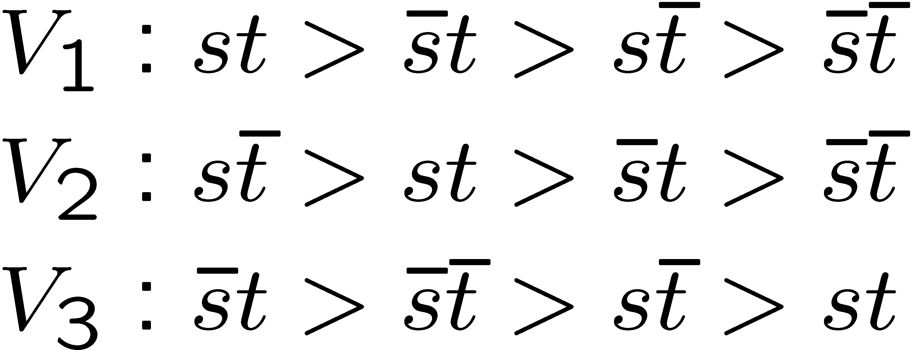
Example (also in [Lacy&Niou00])
S
T
In the first stage, the voters vote simultaneously to determine S; then, in the second stage, the voters vote simultaneously to determine T
If S is built, then in the 2nd step $t>\overline{t}, \overline{t}>t, \overline{t}>t$, so the winner is $s\overline{t}$
If S is not built, then in the 2nd step $t>\overline{t}, t>\overline{t}, t>\overline{t}$, so the winner is $\overline{s}t$
In the first step, the voters are effectively comparing $s\overline{t}$ and $\overline{s}t$, so the votes are $\overline{s}>s, s>\overline{s}, \overline{s}>s$, and the final winner is $\overline{s}t$

Slide 18
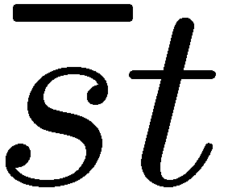
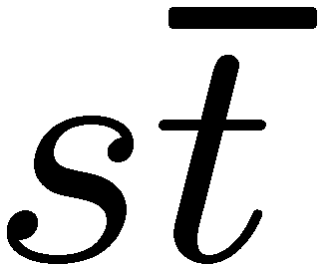
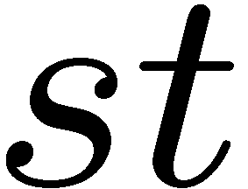
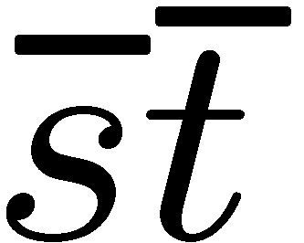
Voting tree
The winner is the same as the (truthful) winner of the following voting tree (a.k.a. knockout tournament)
“Within-state-dominant-strategy-backward-induction”
Similar relationships between backward induction and voting trees have been observed previously [McKelvey&Niemi JET 78], [Moulin Econometrica 79], [Gretlein IJGT 83], [Dutta & Sen SCW 93]
vote on S
vote on T

Slide 19
The choice of O is crucial
Theorem. For any p≥4, there exists a profile P such that any alternative can be made to win under this profile by changing the order O over issues
When p=1, 2 or 3, all p! different alternatives can be made to win
The chair has full power over the outcome by agenda control (for this profile)

Slide 20
Is the equilibrium outcome “good”?

Slide 21
Paradoxes: overview
Strong paradoxes for strategic sequential voting (SSP)
Slightly weaker paradoxes for SSP that hold for any O (the order in which issues are voted on)
Restricting voters’ preferences to escape paradoxes

Slide 22
Multiple-election paradoxes for SSP
Main theorem (informally). For any p≥2, there exists a profile such that the SSP winner is
ranked almost at the bottom by every voter
Pareto dominated by almost every other alternative
an almost Condorcet loser
Known as multiple-election paradoxes [Brams, Kilgour&Zwicker SCW 98, Scarsini SCW 98, Lacy&Niou JTP 00, Saari&Sieberg APSR 01, Lang&Xia MSS 09]
Strategic behavior of the voters is extremely harmful in the worst case

Slide 23
Any better choice of the order?
Theorem (informally). At least some of the paradoxes cannot be avoided by a better choice of the order over issues

Slide 24
Getting rid of the paradoxes
Theorem(s) (informally)
Restricting the preferences to be separable or lexicographic gets rid of the paradoxes
Restricting the preferences to be O-legal does not get rid of the paradoxes

Slide 25
Preventing manipulation by domain restrictions [Xia&Conitzer 10]
Relax the unrestricted domain property in Gibbard-Satterthwaite
We obtained a concise characterization for all strategy-proof voting rules
Over combinatorial domains
Voters’ preferences are lexicographic

Slide 26
Summary
Combinatorial voting is a promising research direction where CS meets Econ
Sometimes strategic behavior leads to very undesirable outcome
Restricting voters’ preferences can avoid multiple-election paradoxes
Thank you!

Slide 27
Are these paradoxes big deal?
Yes
Theorem. Similar multiple-election paradoxes do not exist for many common voting rules when voters vote truthfully

